Slide 1


TPAS
July 2026
Nottingham
Presented by Christine Undrill

Slide 2
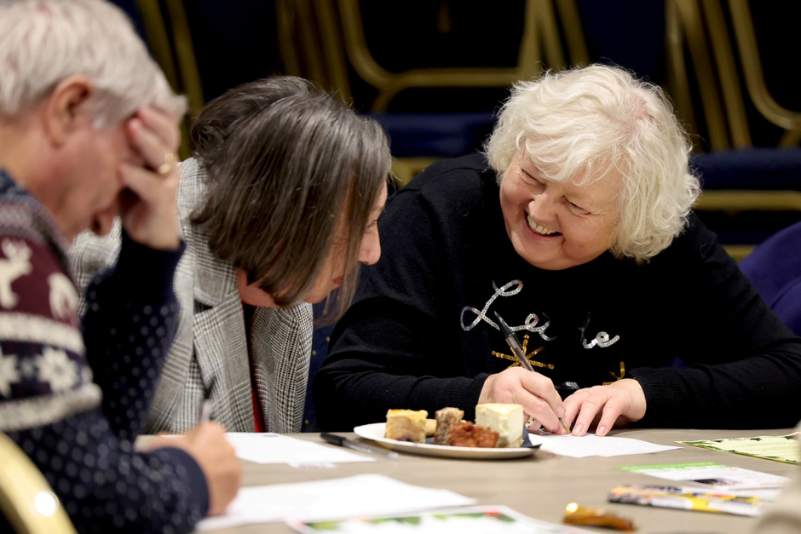

Where we are now..
Re evaluating our role as a tenant panel
Assessing what works and what doesn't
We have met senior members of staff
We have come up with a list of our expectations from senior managers
Being supported by our involvement team and TPAS – developing a plan together
Training/awareness for staff & tenants

Slide 3
Where we are now..
The management team involvement within the council has grown since the grading & they have been redesigning their own structure within their own teams.
Within this, the team are looking at what we do as tenants & how are we all involved together. Evaluating the process.
I think the grading was a positive step change.
This has highlighted areas for tenants to have more say, challenging managers, influencing decisions made & learning new things. I think it has pulled the council & tenants together.
Inspectors were complimentary during the inspection, but tenants needed better opportunities to speak to the executive team. That’s where I come in to this with other tenants on the team. Tenants get to act together and going forward make significant changes.
TPAS – will help us work through this & build a structure, to be the best and be taken more seriously.
Taken steps already by electing a chair and vice chair. Looking at workshops, what do we want to see out of our landlord? Look at performance & engagement, what changes are needed & panel membership.
Head of service working behind the scenes & engaging tenants.

Slide 4
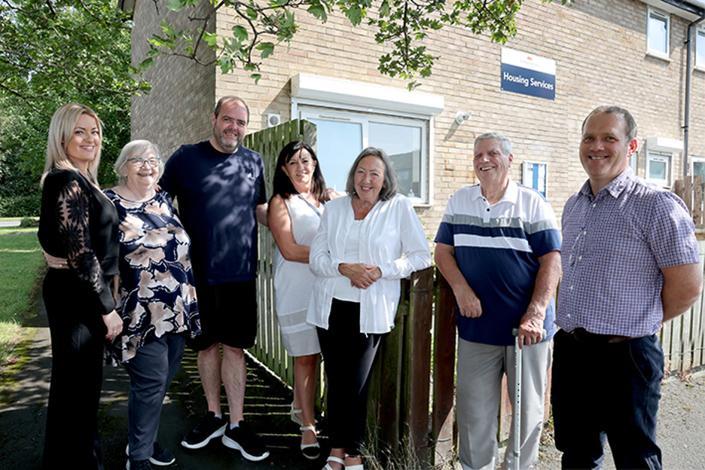
Looking ahead ..
We are confident we are on the right lines
We want to build and strengthen the great relationship(s) already developing with the Senior Leadership Team
We want our perspective to be considered from the very beginning
There is a new Governance Structure for our Housing Department and we are part of that
We are looking forward to being part of the improvement journey

Slide 5
Looking a head..
How do we get there? Influencing? How is money being spent? Get to know the housing team.
We have secured representation by the housing compliance board.
But the structure must be right. How do we feed back to a wider base of tenants?
Confident on the right lines to develop a good relationship with looking forward to the learning journey, as there is always room for improvement.
Even though the grading was C4, it has impacted the landlord but use as tenants to under pin any improvements needed.
Re-evaluate roles of a tenant. What works and what doesn’t.
List of expectations from the housing manager, performance, money spent, voids etc.
Being supported by the customer engagement team is a huge bonus.
Putting a plan in place, training &awareness. Not just here to talk about the result - the onsite process but of the re-evaluation afterwards – improvement will be ongoing.
The grading made us ensure that our perspectives not only improve housing services, but a better understanding of where we need to be – meet monthly. External endorsement.

Slide 6
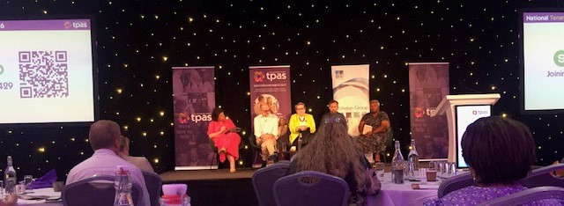
Keynote speakers from the conference
Jenny Osbourne CEO
Jack Smith Regulator
Eve Blezard Policy lead CIH
Joan Allen Citizen tenant board member
Peter Apps Journalist

Slide 7
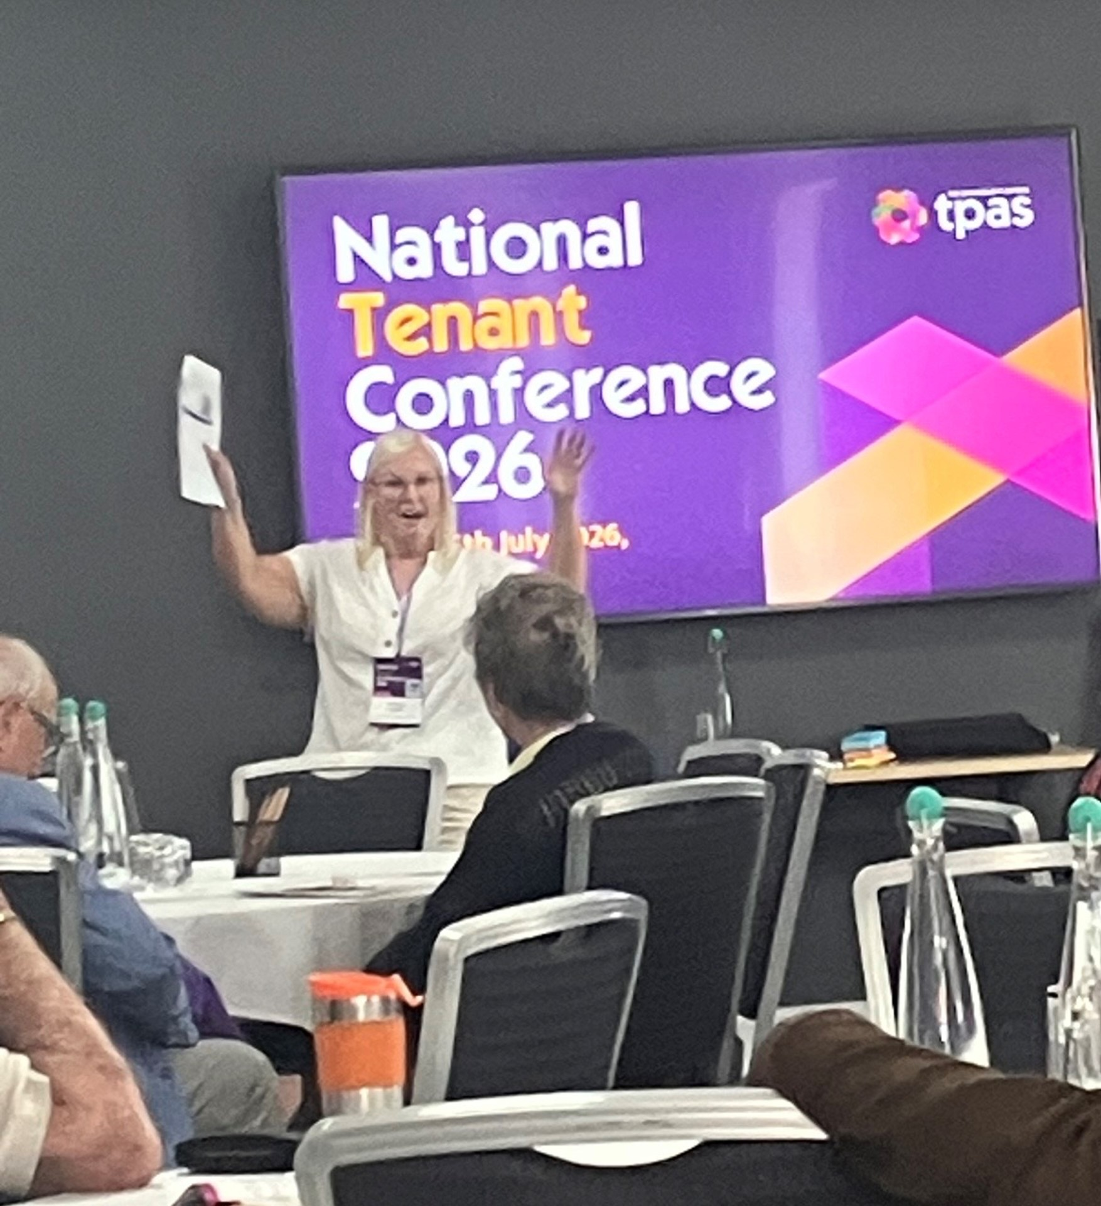
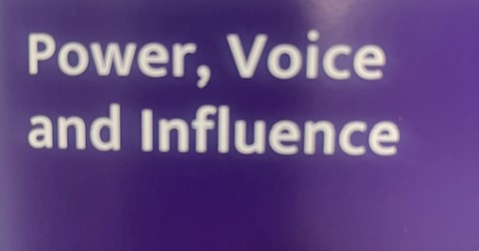
Christine wowing the crowd in full swing

Slide 8
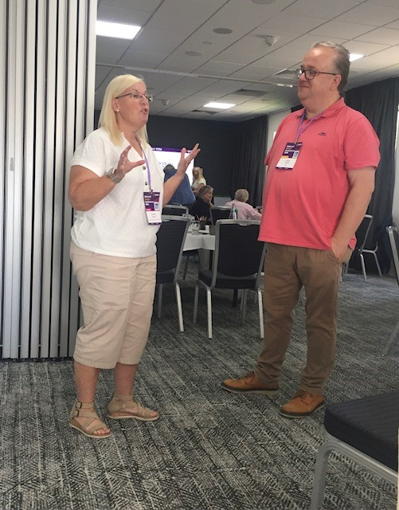
Caritas Charles head of policy for Tpas. Caritas listening intently..

Slide 9
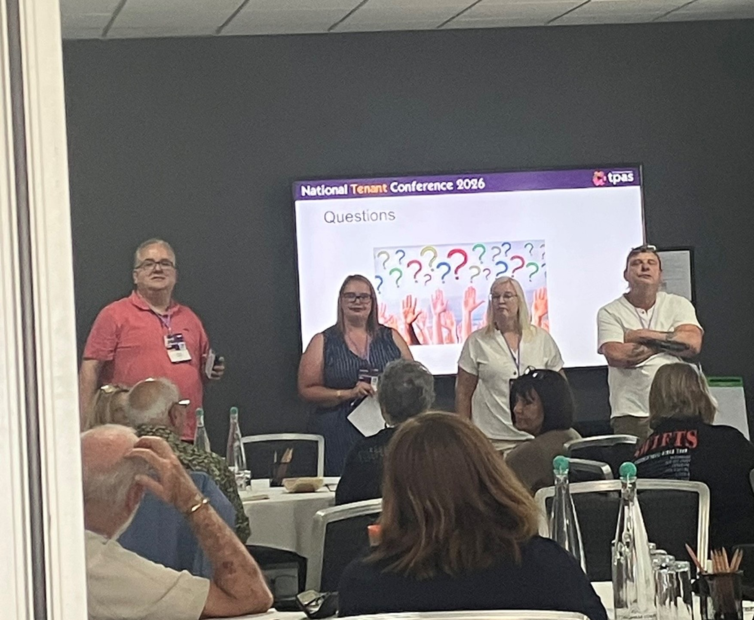
Q&A time for Aspire housing & Northumberland county council

Slide 10
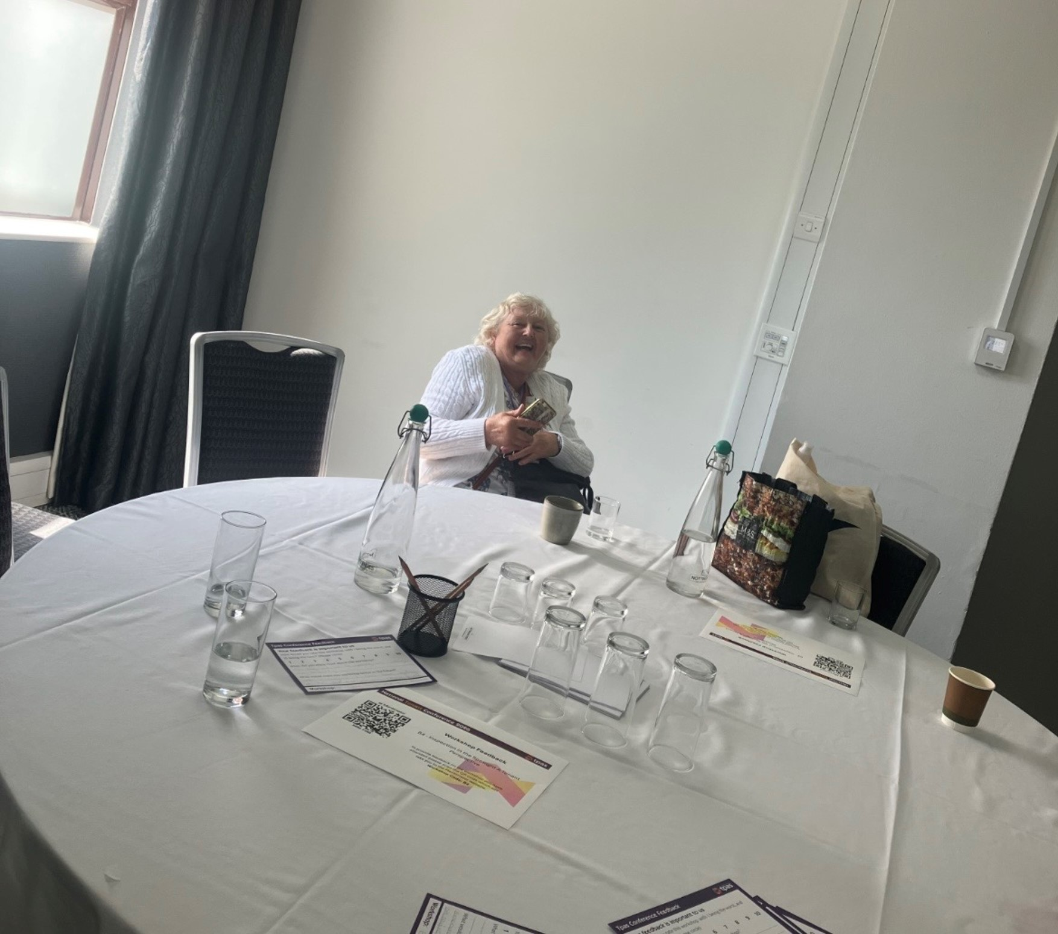
Lynn an involved tenant from Northumberland county council enjoying the conference

Slide 11
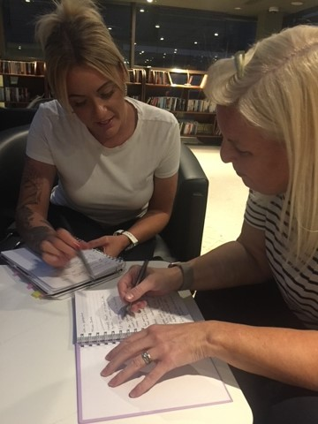
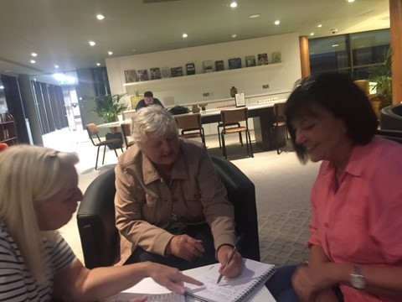
Comparing notes & sharing information from networking

Slide 12
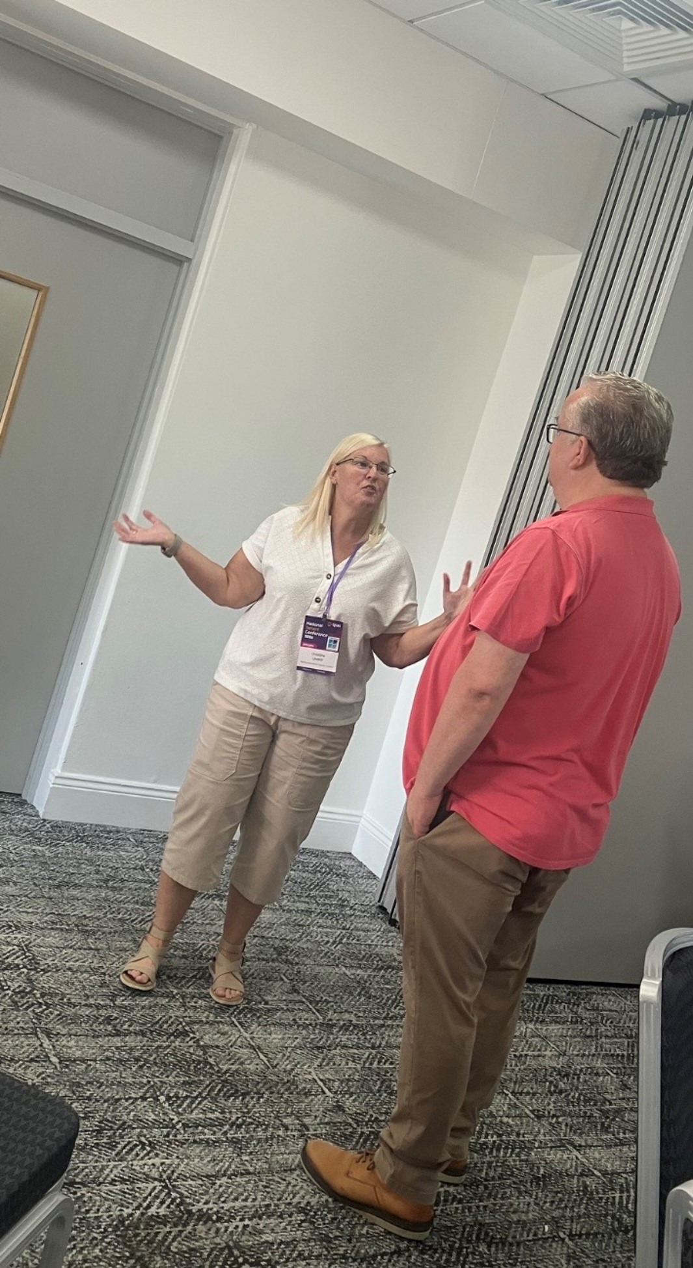

Christine showing Caritas how its done

Slide 13
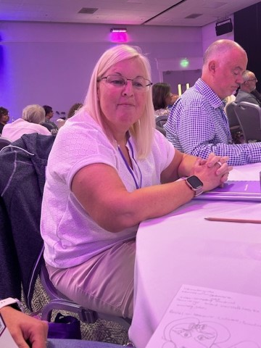
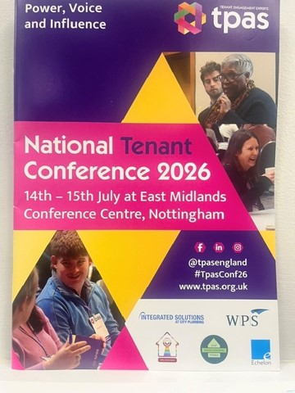
Learning

Slide 14
What did I bring back from the conference
Apart from lots of stationary for my tenant panel ☺
The inspection has a positive impact, ensures better homes, investment and atmosphere.
This is a step change as tenants can influence and be listened too. Wake up call for the landlord – must listen.
By changing the structure on how we work together.
Trust is important.
If no trust, then the communication comes into question.
To be open and transparent develops a relationship which trust comes.
Do I feel this is achievable? Yes, we have this now but can build on it going forwards

Slide 15
What is perfect housing professional?
Understand what the tenant wants & needs
Listen recognise & act
Putting yourself in their shoes
Treat tenants as you would want to be treated yourself

Slide 16
Questions inspectors may ask
How do you know your tenants feel safe & that their home is safe?
What is the level of trust between tenant & landlord?
How many complaints/improvements made as a direct result from complaints?
What have you learnt from the complaints?
How do you involve tenants?

Slide 17
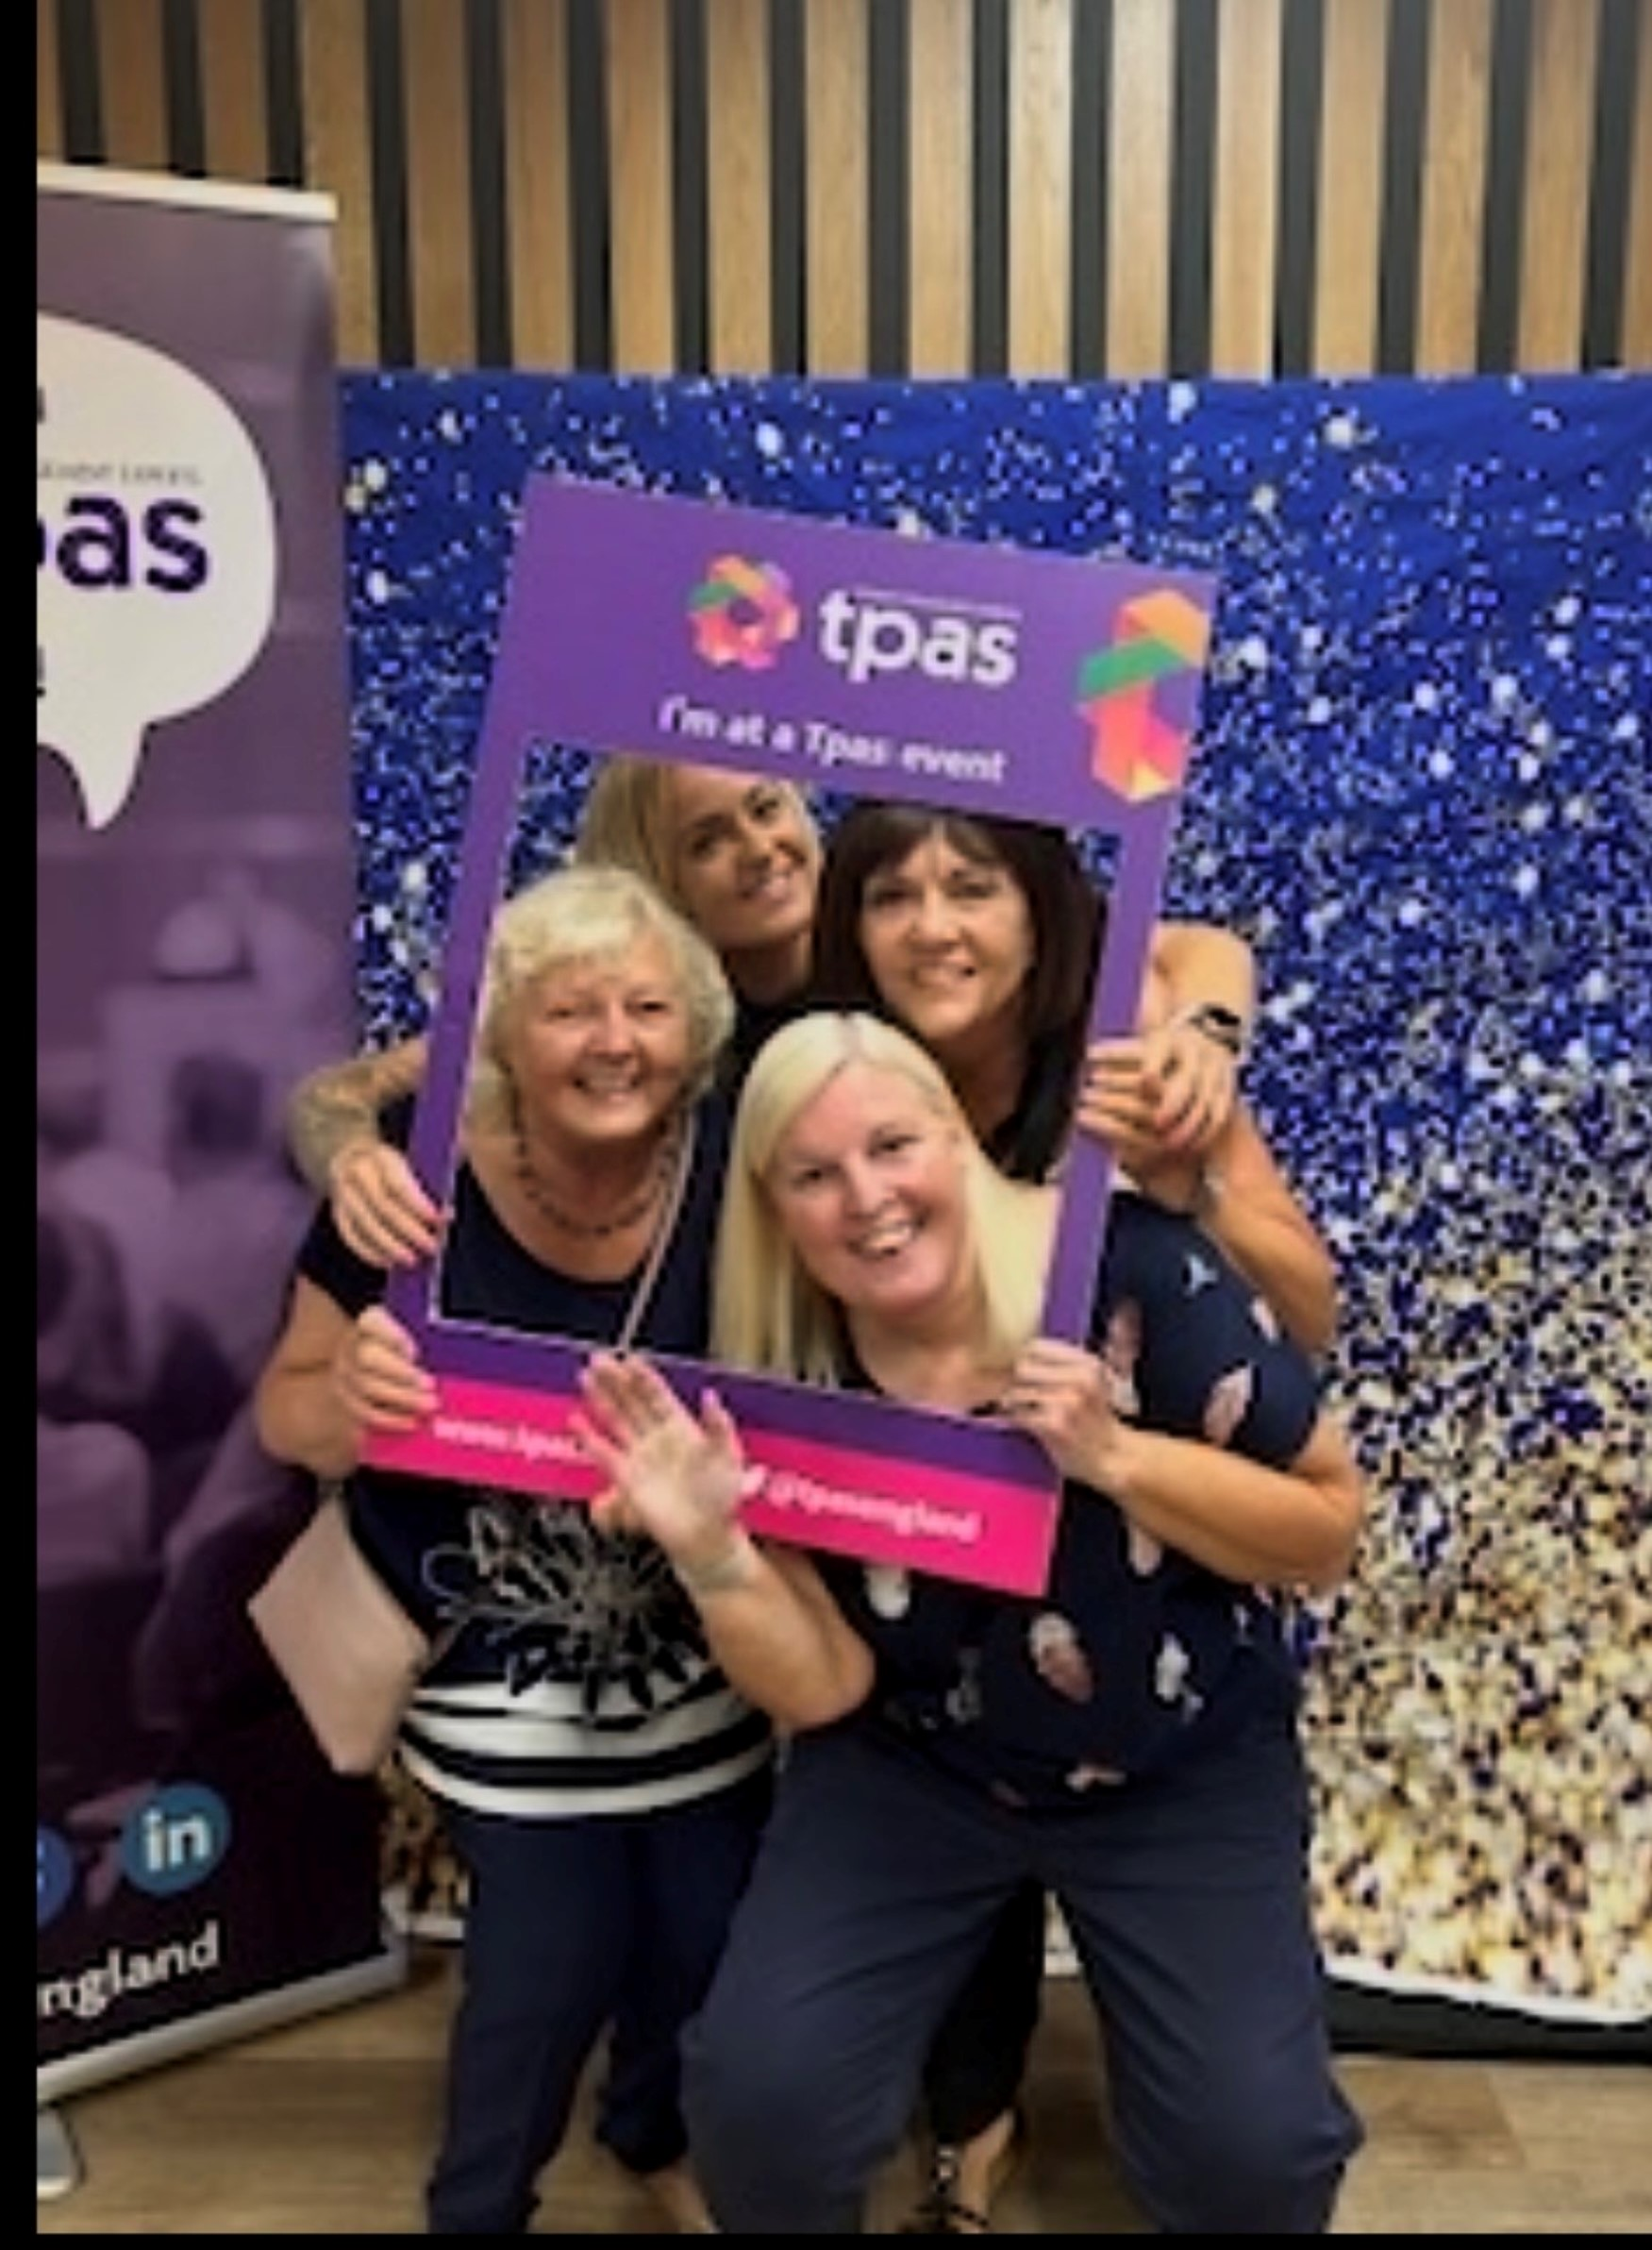
Networking

Slide 18
Thanks to
Tpas
Customer engagement team at Northumberland county council
More so to Mandy Mason & Kirsty Geissler for making this happen for Lynn & I to attend Tpas
Learnt a lot & can certainly utilise this to move forward

